Slide 1

Understanding & Predicting the Stress Level of Nurses During Covid19
Seam Zaman, Shafin Alam, Tanvir hasan, Qiqi Xie
Supervised by Pekka Siirtola

Slide 2
About Data

Slide 3
Project Progress
Phase | Seminar 1 | Seminar 2 | Seminar 3
Familiarity with Data
Research Questions generation
Data merging
Data Cleaning
Exploratory Data Analysis (EDA)
Solution of RQ1
Paper writing |  | Introduction, Related work (50%), Objectives, Data (30%)

Slide 4

Team Role
Tanvir Hasan: Data Analysis & Reporting
Shafin Alam: Data Merging & Pre-processing
Qiqi Xie: Future Plans & Machine Learning
Seam Zaman: Descriptive Analysis, Assisting in data merging & pre-processing.

Slide 5
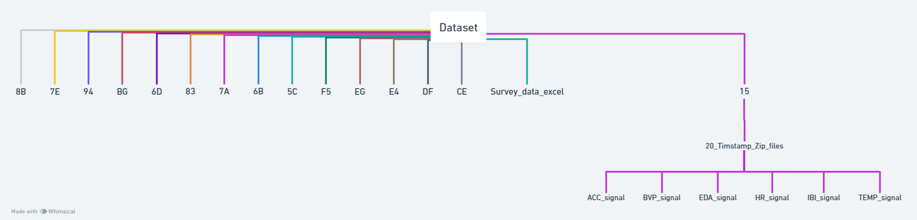
ABOUT DATASET

Slide 6
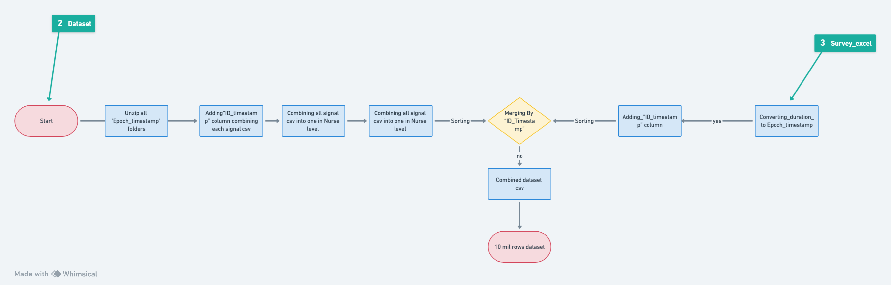
DATASET MERGING PROCESS

Slide 7
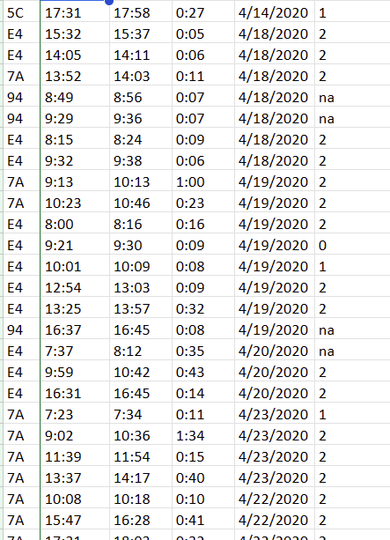
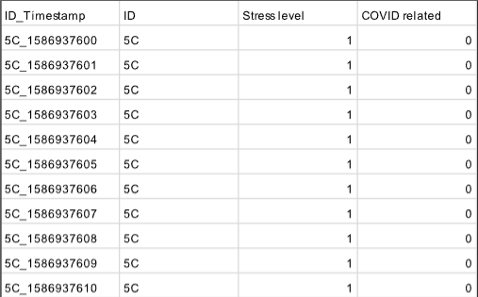
BEFORE
SURVEY DATA TRANSFORMATION
AFTER

Slide 8
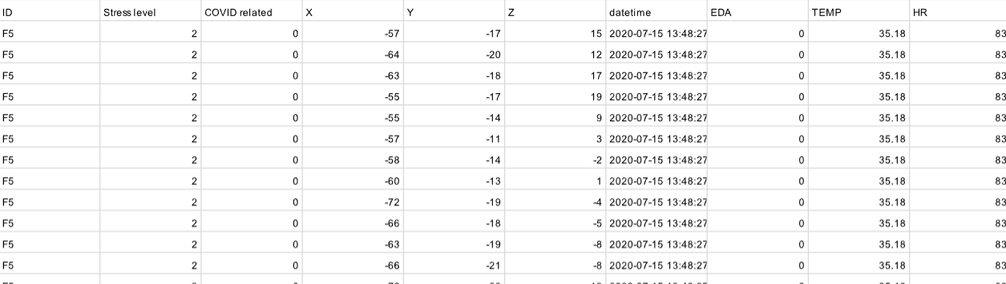
FINAL DATASET

Slide 9
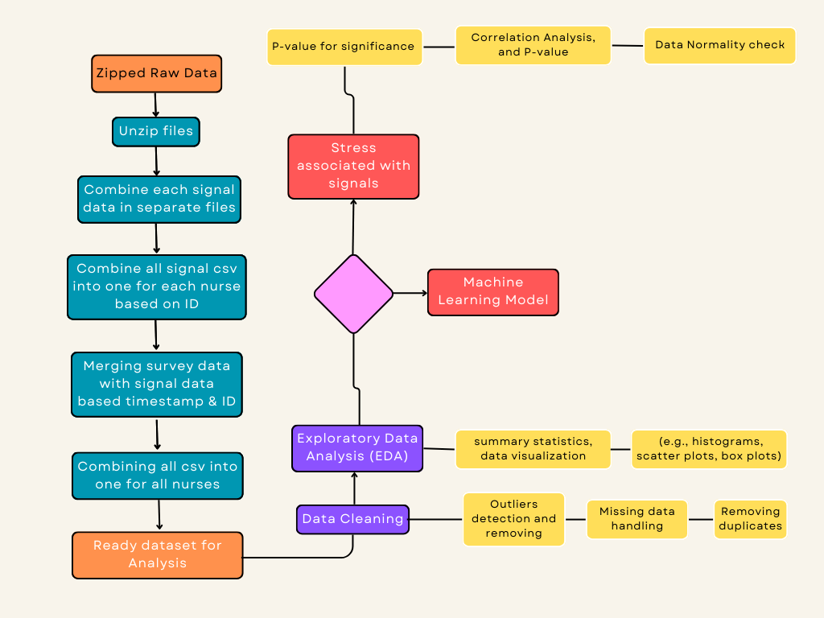
Data Analysis
Figure 1. Data analysis process

Slide 10
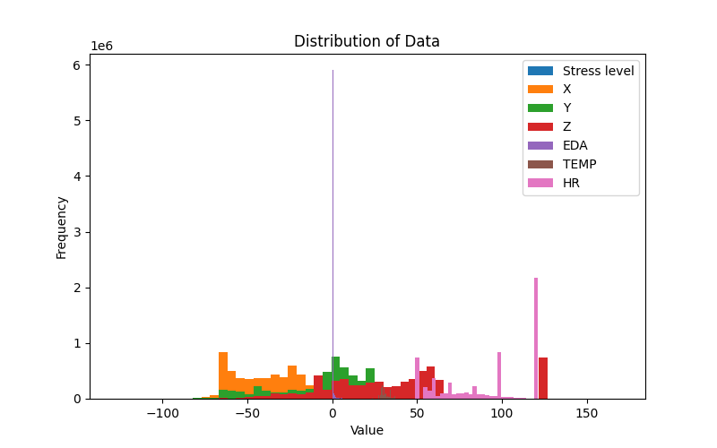
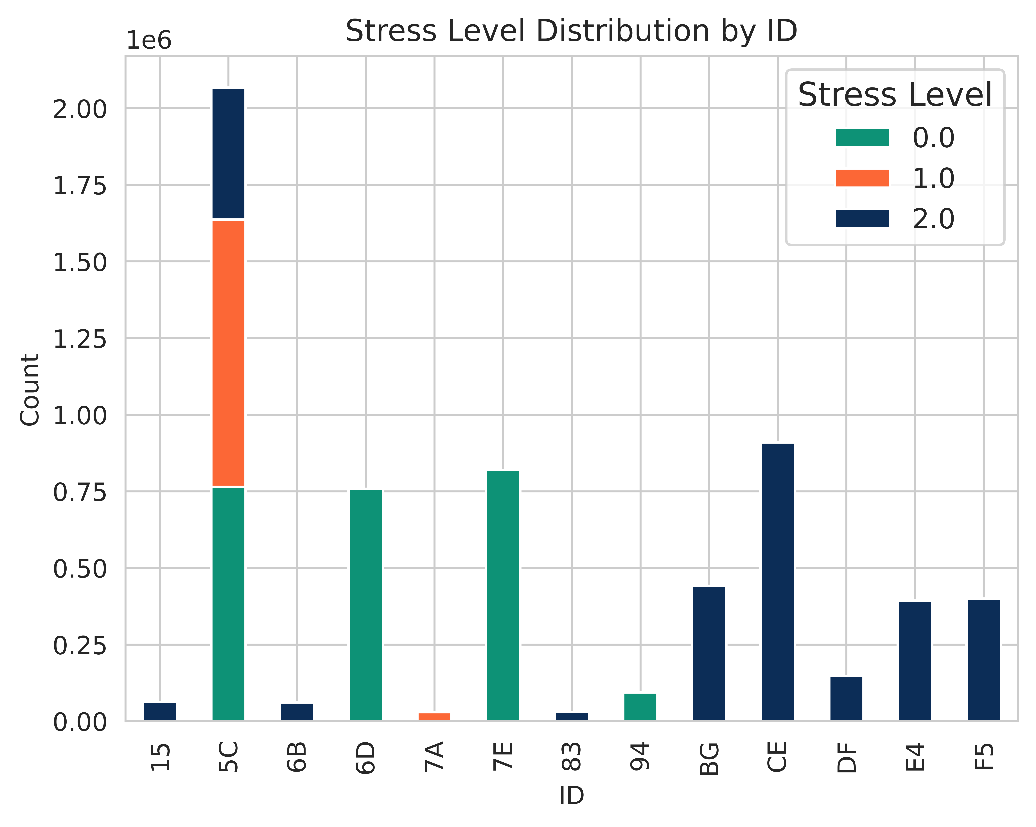
Data Visualization
Based on these results, we reject the null hypothesis and conclude that the data in each column is not normally distributed.
Column Test Statistic P-value
------------ ---------------- ---------
ID 0.646996 0
Stress level 0.726713 0
X 0.961163 0
Y 0.9535 0
Z 0.921572 0
EDA 0.129615 0
TEMP 0.989339 0
HR 0.856894 0
Shapiro-Wilk normality test

Slide 11
Solution of RQ1
Electrodermal Activity (EDA) shows a positive correlation coefficient of 0.285 with stress level. This suggests that as EDA values increase, there is a tendency for stress levels to also increase.
Heart Rate (HR) demonstrates a negative correlation coefficient of -0.114 with stress level. This implies that as heart rate decreases, stress levels tend to increase, although the correlation is weaker compared to EDA.
Acceleration (ACC), and Temperature (TEMP) exhibit very weak correlations with stress level, with correlation coefficients close to zero. This indicates that these attributes have minimal influence on stress levels.
Dependent Variable | Independent Variable | Spearman Corr. Value | P-value
Stress Level | X(ACC) | -0.064 | 0.00e+00
Stress Level | Y(ACC) | -0.063 | 0.00e+00
Stress Level | Z(ACC) | -0.013 | 0.00e+00
Stress Level | EDA | 0.285 | 0.00e+00
Stress Level | TEMP | 0.017 | 0.00e+00
Stress Level | HR | -0.114 | 0.00e+00
The table suggests that EDA and HR have the most notable associations with stress levels, with EDA showing a positive correlation and HR showing a negative correlation.

Slide 12

Future work
Classification in machine learning
Model: GPU-accelerated XGBoost
Time series split and divide the training, testing, validation dataset
Data analysis:
Fine-tuned XGBoost model with key hyperparameters
SHAP analysis detect the relationships that combine to create the model output

